Slide 1

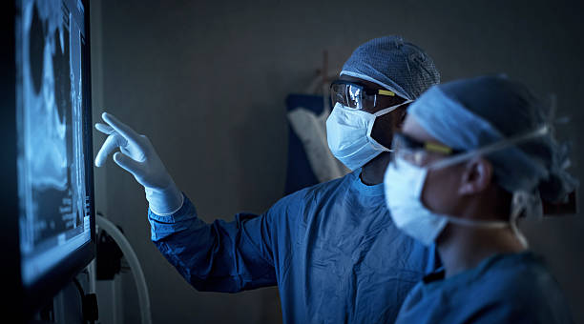
Pneumonia Detection from Chest X-rays
StoryData, Group.
Premiere Project Presentation
Saturday May 25, 2024

Slide 2

Team Lead
Team Members
Kadilobari Baabel
Oguama Prosperity
Sam Ayodeji
Liya T Mathew
Fatima Adwan
Ruth Iroanusi
Akintola Joseph
Wira Satria
Jermiah Adetunji
Asimolowo Kabirat Fikayo
Gaius Ufondu
Kumar Kaushik Ranjan
Project Lead: Adeniran Shaddai Daniel
Assistant: Kadilobari Baabel
Query Analyst: Oyewale Daniel Oyewola

Slide 3
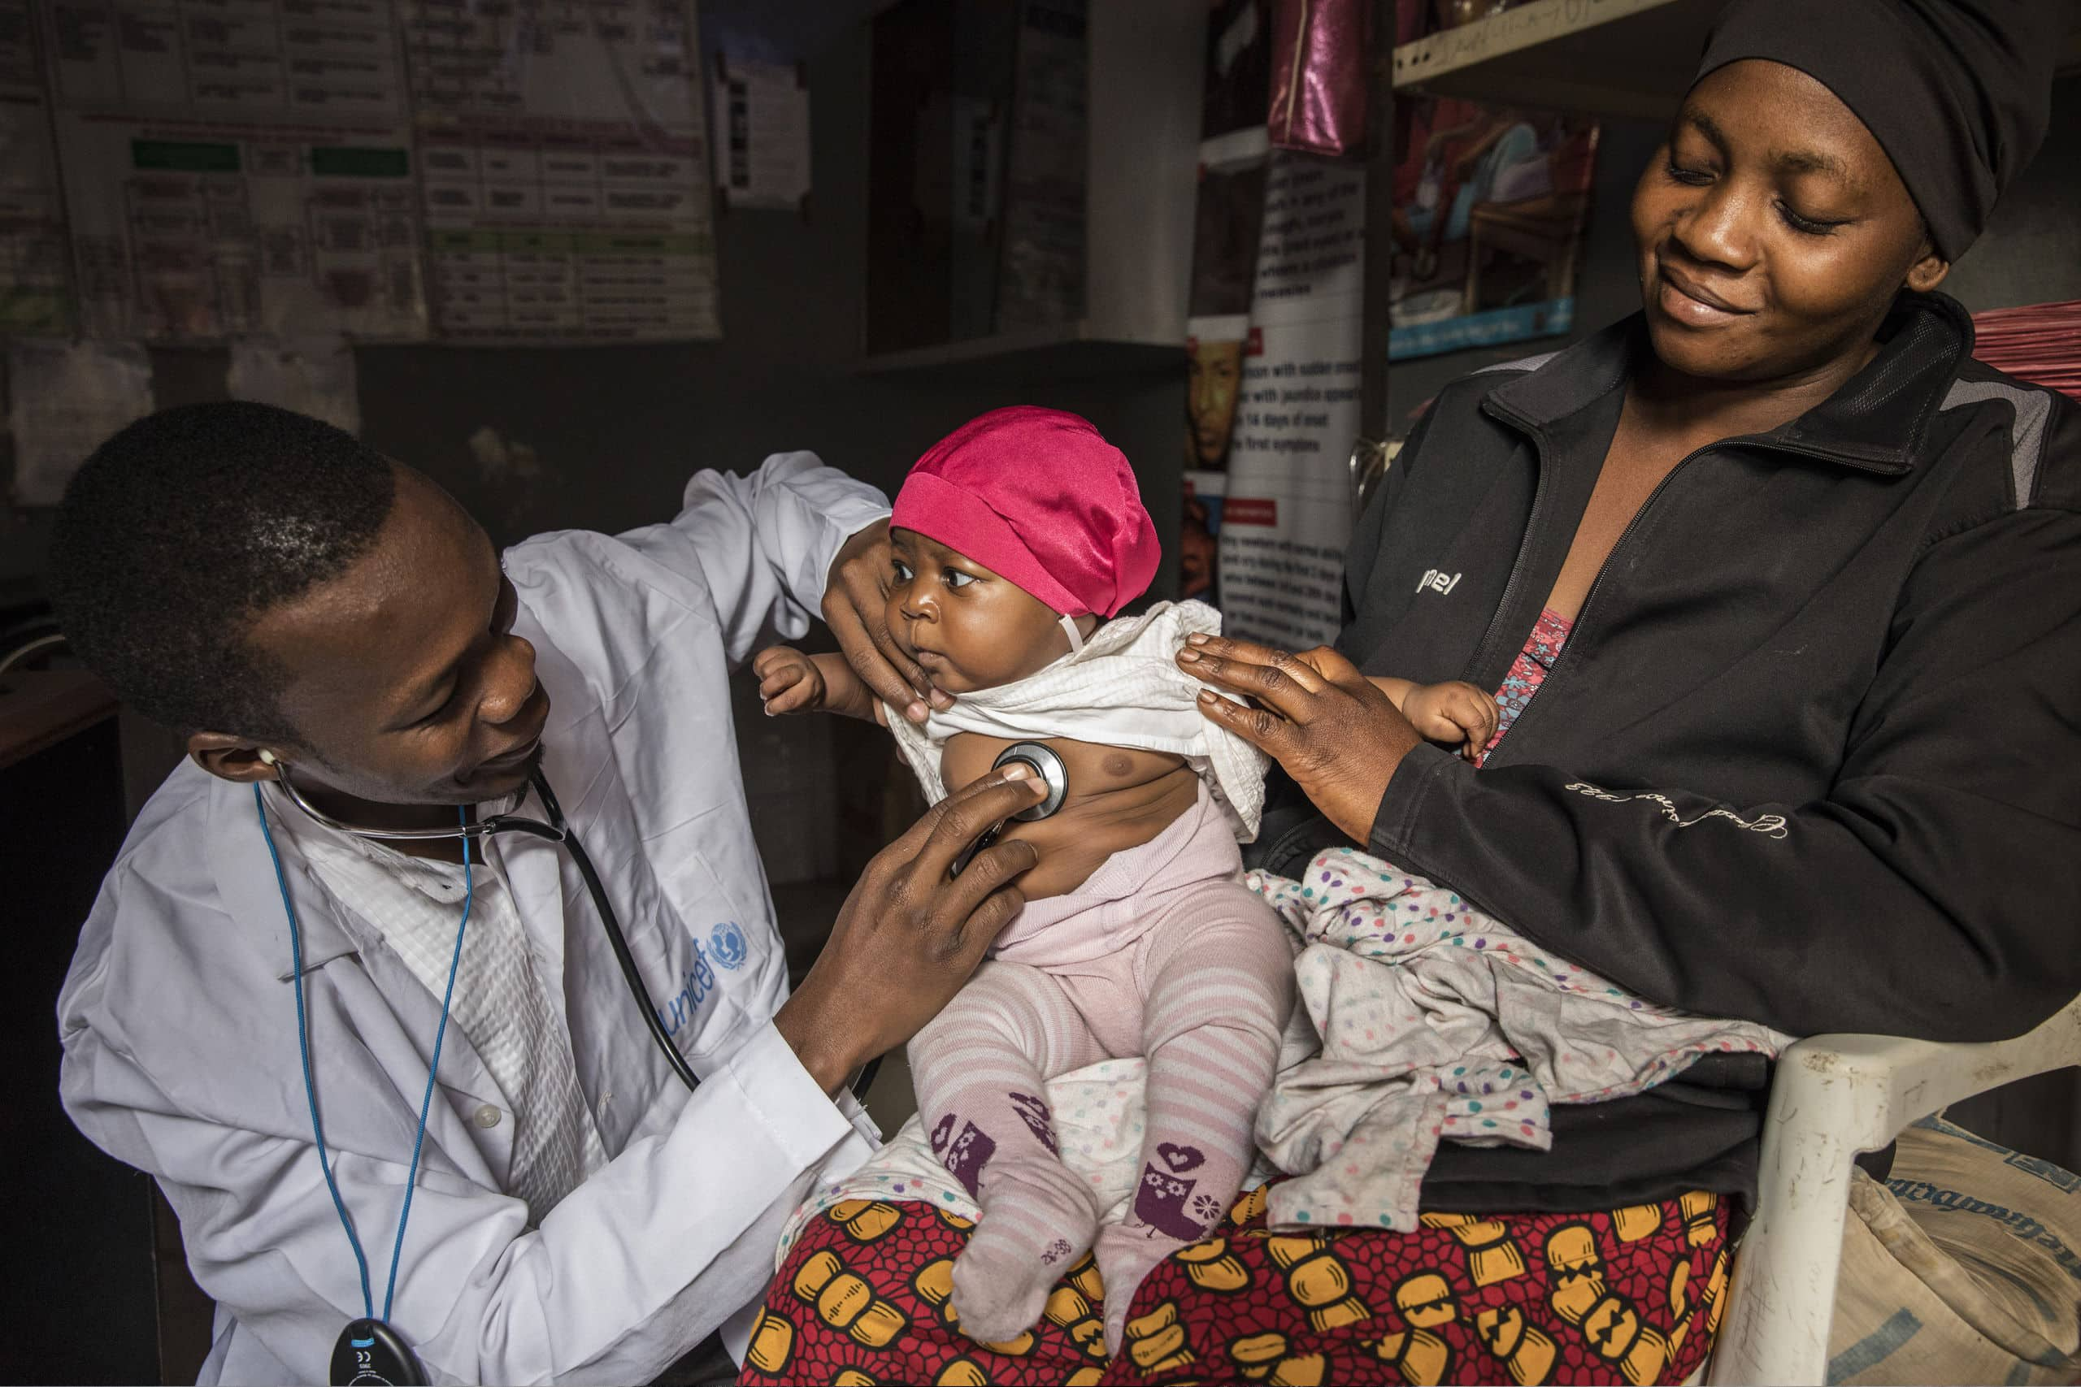
Introduction
Pneumonia Overview:
Inflammatory lung condition caused by infection (bacteria, viruses, fungi).
Symptoms: Cough, fever, chills, shortness of breath, chest pain.
High-risk groups: Infants, older adults, immunocompromised individuals.
Global Health Impact:
Significant public health concern with millions of cases annually.
Timely, accurate diagnosis is critical for effective treatment.
Diagnosis and Treatment:
Diagnosis: Clinical assessment, chest X-rays, laboratory tests.
Treatment: Antibiotics, antivirals, other therapies.
Importance: Prevents complications like respiratory failure, sepsis.

Slide 4
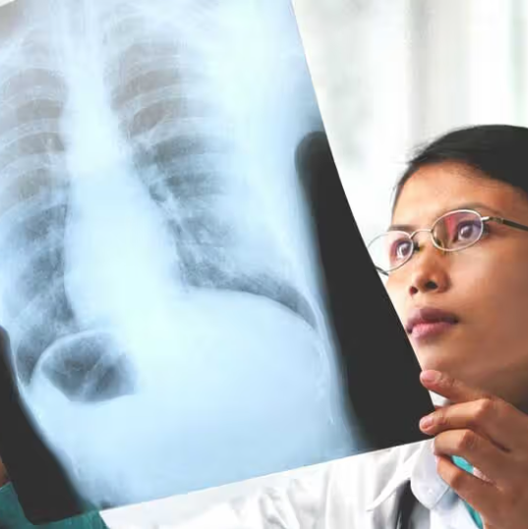

Introduction
Challenges in Traditional Diagnosis:
Reliance on subjective interpretation of chest X-rays.
Risk of misdiagnosis and delayed treatment.
Role of Deep Learning:
CNNs for automating pneumonia detection from chest X-rays.
Improved accuracy and efficiency in image classification tasks.
Study Objective:
Develop a CNN-based model using a publicly available dataset.
Aim: Accurately identify pneumonia, enhance diagnostic accuracy, reduce misdiagnosis and delays.
Scarce Analytics
Fig. 1: Physician Examining Chest X-ray

Slide 5




Our Approach
Interpretability
Enhance interpretability by analyzing false positives.
Uniqueness
Address limitations by focusing on model:
Transferability,
Interpretability, and
Scalability
Scalability
Explore scalability for deployment in clinical settings

Slide 6
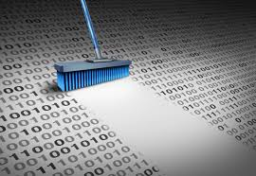
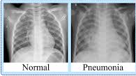
Methodology
Dataset Overview
Data Preprocessing:
Utilized the Chest X-Ray Images (Pneumonia) dataset from Kaggle.
Organized into train, test, and validation folders.
Contains 5,856 X-ray images with categories: PNEUMONIA and NORMAL.
Data labeling:
Assigned numerical labels to classes.
Data transformation:
Resized images;
applied data augmentation.
Dataset
Data Preprocessing
Model Architecture
Model Training and Evaluation
Model Deployment

Slide 7
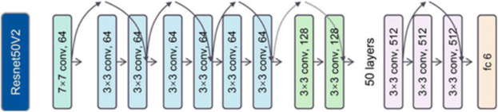
Methodology
Model Architecture
Fig. 2: ResNet50V2 Model Architecture
Based on ResNet50V2 CNN.
Pretrained on ImageNet, fine-tuned on chest X-ray dataset.
Final layer replaced with sigmoid activation for binary classification.
Dataset
Data Preprocessing
Model Architecture
Model Training and Evaluation
Model Deployment

Slide 8
Methodology
Model Training and Evaluation:
Trained using Adam optimizer with callbacks for optimal performance.
Evaluated on test set with:
Accuracy: 0.753
Precision: 0.721
Recall: 0.987
Model Deployment:
Deployed as user-friendly interface for healthcare professionals.
Future work: Explore techniques for performance improvement and interpretability.

Slide 9
Result And Discussion
Model Evaluation
Accuracy
0.7532
Precision
0.7210
Recall
0.9872

Slide 10
Result And Discussion
High Recall
Lower Precision
Suggests a higher number of false positive predictions.
Could lead to unnecessary follow-up tests or treatments, increasing healthcare costs and patient anxiety.
Trade-off between recall and precision favors higher recall for medical diagnosis.
Indicates effective identification of pneumonia cases, minimizing false negatives.
Crucial for medical diagnostics to prevent missed diagnoses and potential health risks.

Slide 11
Conclusion and Recommendations
Conclusion
Recommendations
CNNs show potential in pneumonia detection from chest X-rays.
Precision and overall accuracy have room for improvement.
Implications:
Highlights deep learning's role in automating medical image analysis.
Indicates efficacy in identifying positive pneumonia cases.
Advanced Model Architectures:
Explore advanced CNN architectures or ensemble methods.
Incorporate attention mechanisms, multi-scale features, or 2D/3D convolutional layers.
Multimodal Learning:
Integrate additional data sources like patient metadata or clinical notes.
Provide comprehensive diagnostic insights through multimodal approaches.

Slide 12


Thank You
StoryData, Group.
Github Repository: https://github.com/Story-data

